Slide 1
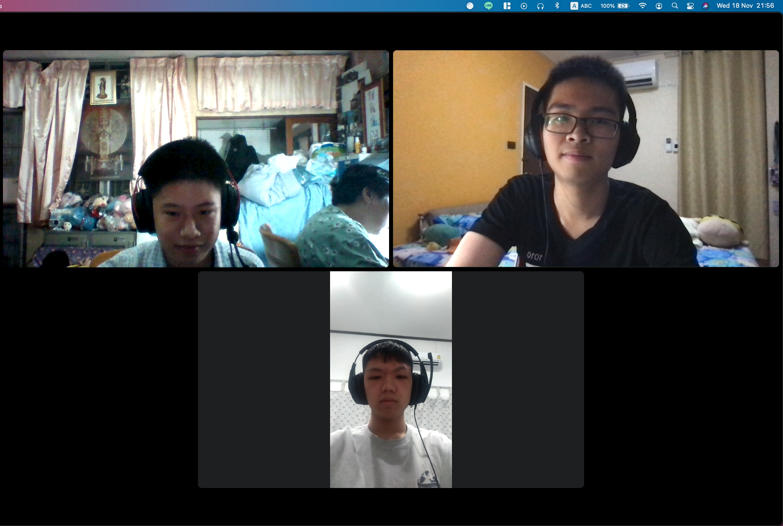
AI-shiteru
Autistic people in Thailand are unemployed
Autistic Thai Foundation

